Slide 1
#MSHK #OPENHACKHK
Wi-Fi: Openhack_guest
Password: openhack2019
Hong Kong | Mar 12-14
Notes:
There are separate wifi logins for each person, please use this to login to wifi

Slide 2
 | Tuesday, 3/12 | Wednesday, 3/13 | Thursday, 3/14
 | Architecture Design Sessions throughout the day
9:00 - 9:30 | Registration, Breakfast
9:30 - 10:00 | OpenHack Kickoff | Daily Announcement | Daily Announcement
10:00 - 12:00 | Team Hacking | Team Hacking | Team Hacking
12:00 - 13:00 | Lunch | Lunch | Lunch
13:00 - 13:30 | Technical Talk | Technical Talk | Technical Talk
13:30 - 16:30 | Team Hacking | Team Hacking | Team Hacking
16:30 - 17:00 |  |  | Recognition, Awards
17:00 - 17:30 |  |  | Event Closing
17:30 - 18:00 | Team Retrospective | Team Retrospective
Schedule
Notes:
Here is our schedule for the three days of OpenHack.

Slide 3
Challenge Based: increasing difficulty
Team Based: work together and communicate
Immersive: real-world scenario
Gamified: fun and friendly competition
Notes:
What is OpenHack?
- This is not a tutorial or workshop. It’s hands on and involves a set of challenges. There will be search engine usage and reading of product documentation.
You will be programming in Python, if you aren’t comfortable with this language, lean on others in your team
Teams that work together get further
Taking time to read documentation or go through a tutorial will save you time in the long run. Added bonus from doing this work on your own, you’re surrounded by teammates and have experts in the room to give you the chance to ask questions
This is based on a real pattern we’ve seen working with our customers – customers and partners we work with have faced the same concepts and learning paths
While this is a competition, if there is a team that is through a challenge your team is struggling with, consider asking a team who is further along how they approached it.
In working with others there are a few things to consider…

Slide 4
Meet the Coach Team
Table & Coach Mapping
Table 1 Alex Zhao | Table 2 Tim Scarfe | Table 3 Tim Scarfe | Table 4 Zhansheng Pan | Table 5 Xiaoming Jia
Table 6 Angus Tong | Table 7 Bo Wang | Table 8 Warren Wong | Table 9 Aaron Chong | Table 10 Jan Pospisil
Table 11 Jan Pospisil | Table 12 Jianhui Lu | Table 13 Delon Yau | Table 14 Sean Ma | Table 15 Samson Wong
Table 16 Zhuohuan Li | Table 17 Zhuohuan Li | Table 18 Guomao Ding | Table 19 Brian Lee | Table 20 Tao Yang
Table 21 Verlebie Chan | Table 22 Samson Lee | Table 23 Hailiang Wang | Floating Coach Shijun Liu

Slide 5
Meal times/breaks
Breakfast: 9:00am – 9:30am
Tea Break: 10:45am – 11:00am
Lunch: 12:00pm – 1:00pm
Tea Break: 3:30pm – 3:45pm

Slide 6
Daily Survey
4:30 PM – 5:00 PM
Your feedback is crucial

Slide 7
OpenHack Event Code of Conduct
Microsoft’s mission is to empower every person and every business on the planet to achieve more. This includes at OpenHack where we seek to create a respectful, friendly, and inclusive experience for all participants.
As such, we do not tolerate harassing or disrespectful behavior, messages, images, or interactions by any event participant, in any form, at any aspect of the program including business and social activities, regardless of location.
We do not tolerate any behavior that is degrading to any gender, race, sexual orientation or disability, or any behavior that would violate Microsoft’s Anti-Harassment and Anti-Discrimination Policy, Equal Employment Opportunity Policy, or Standards of Business Conduct. In short, the entire experience at the venue must meet our culture standards.
We encourage everyone to assist in creating a welcoming and safe environment. Please report any concerns, harassing behavior, or suspicious or disruptive activity to venue staff, the event host or owner, or the nearest security guard or event staff.
Microsoft reserves the right to refuse admittance to, or remove any person from OpenHack at any time in its sole discretion.
Notes:
We ask that you respect and be considerate of others, giving everyone a voice and equal treatment. Report any concerns to your coach or the event staff at any time.
Now on the story…

Slide 8

Your team will partner with Adventure Works, a large outdoor equipment retailer to perform advanced image analysis on product catalog data.
Notes:
You and your team have been recruited by outdoor equipment retailer Adventure Works to work with their team of Data Scientists
What will that look like…

Slide 9

Go “onsite” to Camp Muir on Mount Rainier
Raw image data from AdventureWorks
Machine Learning solution to classify gear
Notes:
As part of a Data Science Team partnering with Adventure Works experts, your team must go to 10,000 feet or 3048 meters on the side of Mt. Rainier at Camp Muir where some of the data is being collected.
Adventure Works has provided you with their raw catalog images so that the team can get started by preparing the data and providing small proof of concepts along the way to show how work is progressing.
The machine learning solution, even though just a part of the data science process, is an important one.
Imagine if you will, eventually a larger solution will involve real time image capturing at this camp and others around the world.
We need to know the class of gear in order to create larger solutions such as:
Inventory optimization
Retail forecasting
Manufacturing applications
Let’s set the stage for the type of work we will do as teams…

Slide 10




clean
Machine Learning tasks involve more than just Machine Learning.
transform
data!
collect
visualize
Notes:
Usually a good amount of time is spent on data.
If going the route of custom ML, ML tasks should include:
Asking a sharp question usually from the stakeholders
Collecting data
Visualizing data
Clean data
Transforming data
Training an ML model
Evaluating an ML model
Back to asking more questions
When looking at the workflow of ml/data science, it’s easy to see how important the data is and how much work is sometimes needed to get the data prepared for machine learning tasks to do well
Deep learning is not the only part of ML, no matter how much attention it gets.
To get here you won’t be alone.

Slide 11
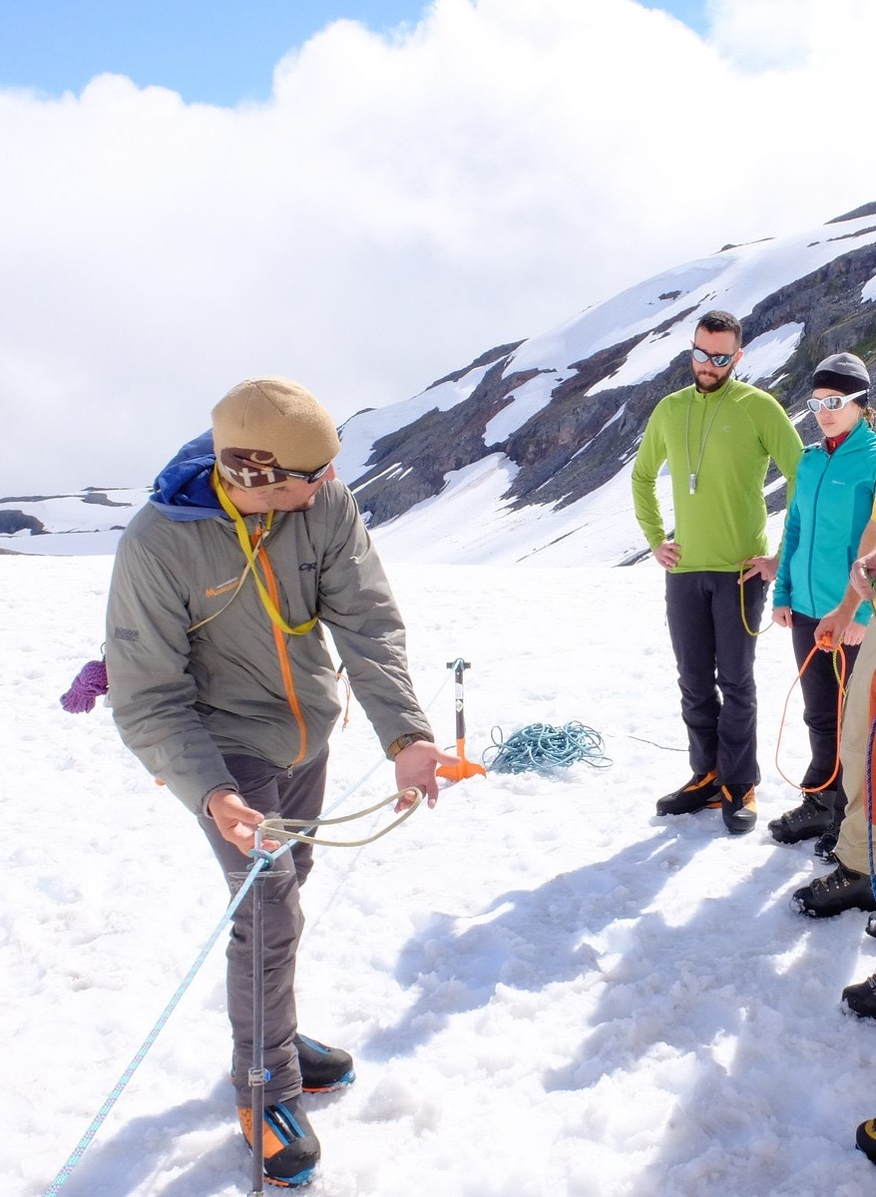
has provided you with an experienced coach.
Not to give away answers, but to use as a guide
Notes:
There will be frustration along the way, no doubt. Think along the lines of a hackathon/hackfest and note you will be using a search engine quite a bit and getting creative.
Remember, when you face a barrier, someone on your team may be a great temporary coach!
In summary, how do you succeed?

Slide 12
Tips for a successful OpenHack
1. Pay attention to details
2. Master teamwork
3. Problem-solve
Barrier == creativity Blocker == ask coach
Notes:
Pay attention to details: read everything carefully
Master teamwork: teams that work together get further and all members must complete the challenge to advance -
Problem-solve: This will be challenging and frustrating at times. Talk through it, try new approaches, take a break
- guidance may even come from a different team. This a friendly competition. Not to say we don’t have prizes.
When you hit a barrier, be creative to solve it; when you hit a blocker, let your coach know (don’t get stuck too long).
You will get an opportunity to play with a lot of different technologies.

Slide 13
You will get stuck all the time.
It is OKAY to be frustrated.
Your A-HA moment will come.
Your coach may share concepts, technology, but not solution.
Go as further as you can.
This is NOT a competition.
Notes:
1. Even if you think you know the way, along the way you’ll still get stuck.

Slide 14
Tooling for ML OpenHack (the tech)
Open Source
Microsoft
Notes:
As an important side note, Microsoft was the largest contributor to open source projects on GitHub in 2016 (https://octoverse.github.com/2016/) and 2017 (https://www.infoworld.com/article/3253948/open-source-tools/who-really-contributes-to-open-source.html)
I’ll leave it at that for now as I don’t want to give anything away.
We not only have the guides and the tech….

Slide 15
Get started…
https://openhacks.azurewebsites.net/

Slide 16
Please DO NOT share the challenges and your solution publicly.

Slide 17
Good Luck &
Happy Hacking!

